Slide 1
Deep Learning on Remote Sensing Data
- under the guidance of
Prof. Uttam Kumar
Vivek Shukla (MT2017141)
Hatim Bohra (MT2017138)
Devesh Prasad (MT2017132)

Slide 2
Why the need arises?
The previous methods were mostly manual and could not be scaled to a large extent
The advent of huge computational power led to the rise of deep learning techniques
Research paper.

Slide 3
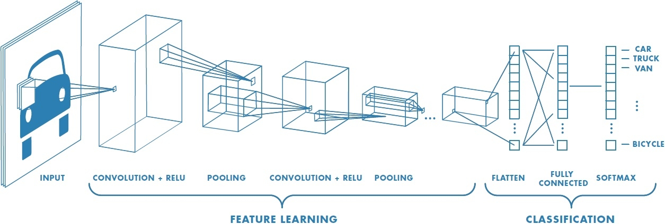
Convolutional Neural Networks

Slide 4
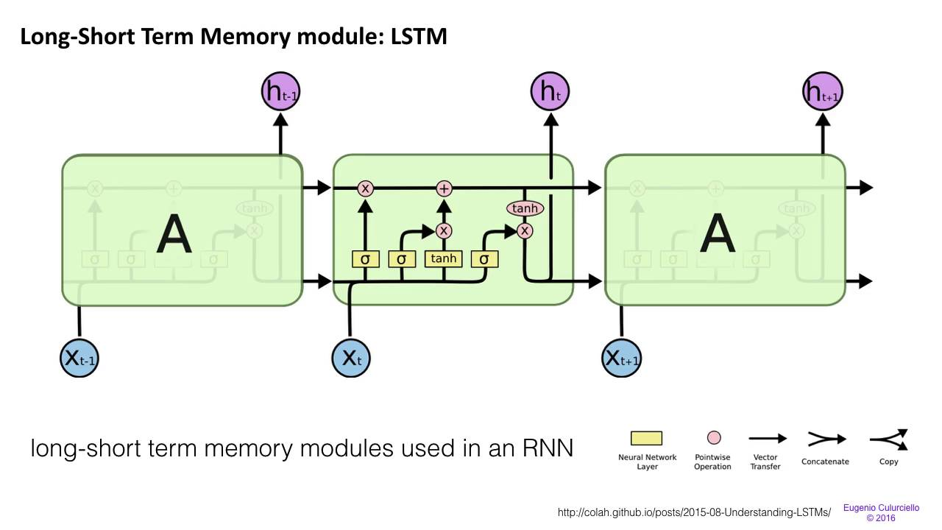
RNNs using LSTM

Slide 5
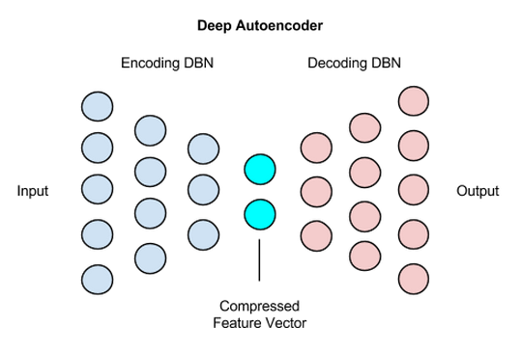
Autoencoders

Slide 6
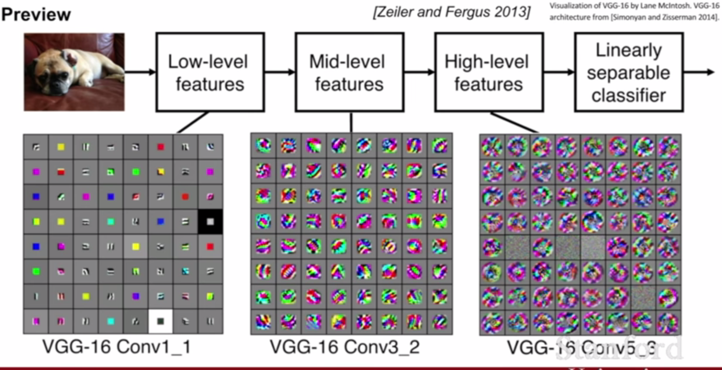
Features Extraction..

Slide 7

VGG16 Architecture

Slide 8
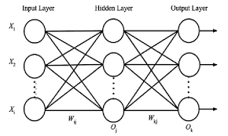
Developing the model..

Slide 9
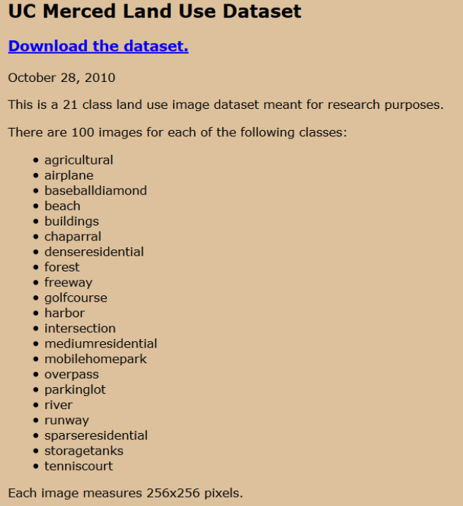
Data set

Slide 10
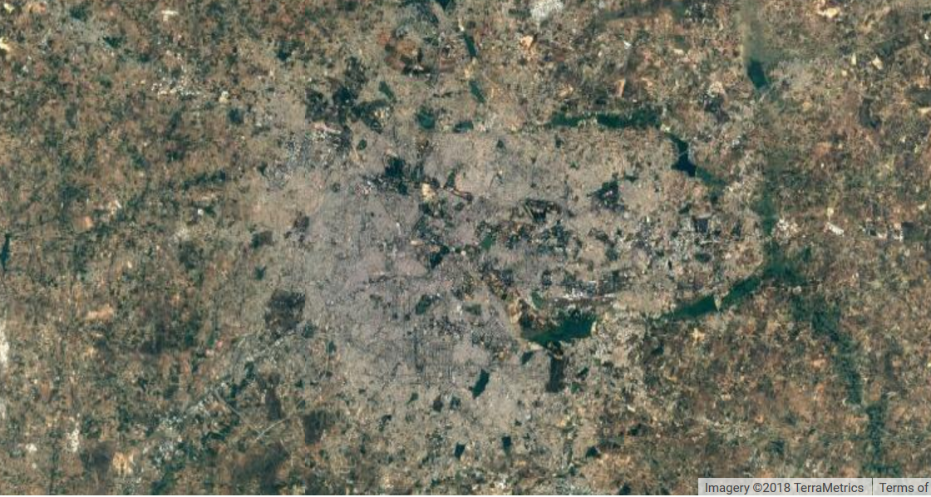
Scanning Bangalore and saving the co-ordinates

Slide 11
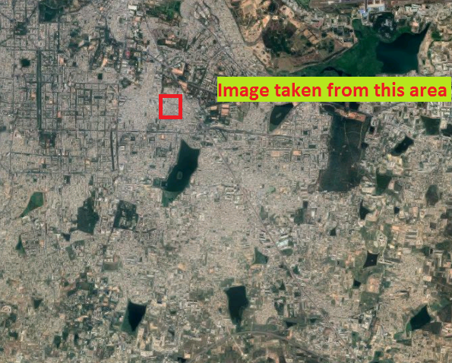
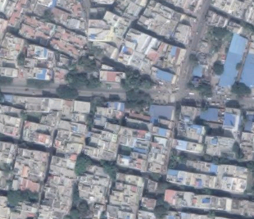

Slide 12
Implementation Details
After getting the JSON file of the extracted features from the Remotely Sensed image
The WebApp reads the coordinates saved in the JSON file accordingly
As the feature is selected in the drop-down menu, the app refreshes the map accordingly
The coordinates are then sent via Google Maps JavaScript API to generate a heatmap

Slide 13
Implementation Details (Contd.)
We search for the co-ordinates in the map , then generate the heat map.
We have used node.js ,JavaScript, html/css to develop the software.

Slide 14
Scalability
This application can be used to track water bodies , forests count and other natural bodies in the state.
It can be used to monitor human settlements and to know where residential areas are growing.
It can be used for many humanitarian works and can serve great purpose for ecosystem.

